Slide 1
Lecture 6a
(Coding) and Multiplexing

Slide 2
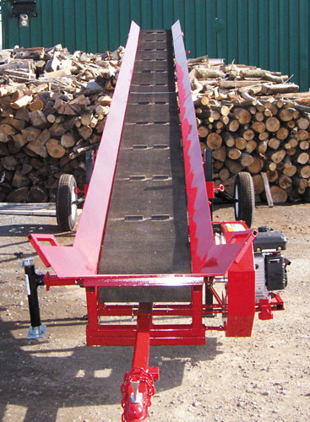
Channel Capacity
Noise impacts the rate at which information can be sent of the channel
Lumber on conveyor belt
How do we best pack it?
Over simplified view in an AWGN channel
Capacity (C) = maximum rate in bps
In bits per second
Rate at which data is communicated over channel
Bandwidth (B)
In cycles per second, or Hertz
Constrained by transmitter and medium
SNR
http://www.hud-son.com/images/forestry-equipment/wood-conveyors/hud-son-wood-conveyor-c24b-01.jpg

Slide 3
Channel Capacity
Capacity in an additive white Gaussian Noise channel
C = B log₂(1+ SNR)
Note C increases with SNR and B
Idea of capacity is complicated
Coding!
B=1
Capacity
SNR

Slide 4
Example: Channel Capacity
A twisted pair telephone line has bandwidth = 4000 Hz and a SNR of 20 dB. What is the channel capacity?
SNR = 20 dB => 20 = 10 log₁₀ (SNR) → SNR= 10² = 100
C = B log₂ (1 + SNR) = 4000 [log₁₀(101)/log₁₀(2)]
= 4000[2.004/0.301] = 26,635 bps

Slide 5
Bit Error Rate or Probability of Bit Error
Oversimplified view
Let us say we transmit 1000 bits repeatedly 10 times
Let us say that the receiver gets 999, 998, 1000, 995, 1000, 1000, 1000, 1000, 1000, 998 bits correctly
The average number of bits in error for every 1000 bits sent is (1 + 2 + 0 + 5 + 0 + 0 + 0 + 0 + 0 + 2)/10 = 1 bit
The bit error rate is 1/1000 or 10⁻³
Bit error rates are on the order of 10⁻⁹ in optical fiber links, higher on copper, and much higher on radio links
Depends on modulation scheme, distance, SNR, and other factors

Slide 6
Noise and Bit Error Rate
Noise impacts BER
Higher noise => more errors
Waterfall curve in AWGN channels
As M increases in M-ary PSK or QAM, BER increases
Bit Error Rate
SNR per bit in dB

Slide 7
Error Control Coding
Systematically add redundant bits for error detection or correction
Part of link layer, but sometimes part of physical layer
Approaches to error control
Error Detection + ARQ ➔ Link layer
Error Correction (FEC) ➔ Physical layer
Error Control Coding
Error
Detection & ARQ
Forward Error
Correction

Slide 8
Error control coding (2)
Error detection codes (more at link layer)
Detect whether received word is a valid “codeword”
May not have enough redundancy to correct bits
Retransmit data after error
Automatic repeat request – ARQ
Error correction codes
Forward error correction: FEC
Detect invalid codewords and correct into valid codeword
Correction requires more bits than error detection
FEC is good for one-way channels, recordings (CD-ROMs), real-time communications, deep space,...
Generally more bits are required to protect against larger number of bit errors

Slide 9
Multiplexing
Slide modified from Agrawal
Sending multiple signals simultaneously on the same medium
Multiple TV channels on one coax cable, or
Multiple radio stations on the same air space
Extremely important milestone in data communication
Drastically reduced need for cabling
Cabling costs are one of the biggest fixed cost components of datacomm

Slide 10
Multiplexing
“Super-channel”:
Cable of wire pairs of fibers
CATV co-ax which is FDM-ed
Digital carrier system (T1 or SONET) which is TDM-ed
One fiber which is WDM-ed

Slide 11
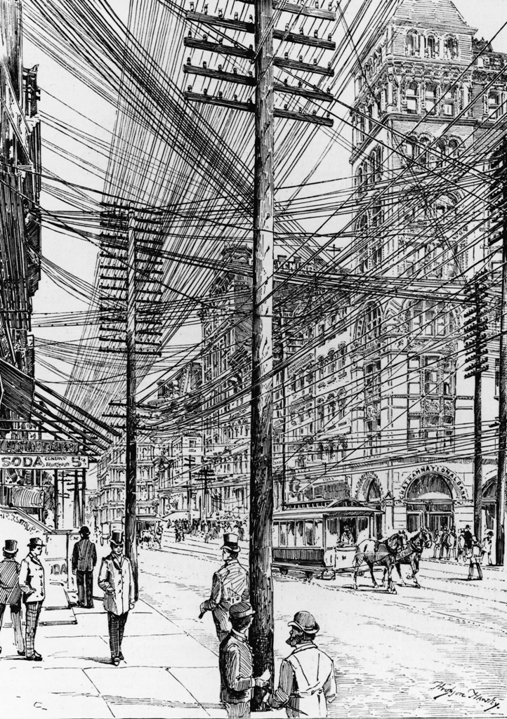
Networking without multiplexing
Slide modified from Agrawal
NYC around 1900

Slide 12
Why multiplexing
Slide modified from Agrawal
Previous pictures show NYC before multiplexing was possible
Multiple telephone lines between same locations required multiple physical cables
Result: cable blanket over large metros
With multiplexing, most cables on one tower can be replaced with one cable

Slide 13
Multiplexing categories
Slide modified from Agrawal
Send signals in different frequency bands
Called frequency division multiplexing (FDM)
Used with analog signals (perhaps carrying digital data)
Send signals at different times
Called time division multiplexing (TDM)
Used with digital signals and analog signals carrying digital data
Multiplexing in code
Called Code Division Multiplexing (CDM)
Used in 3G cellular systems
OFDM – Orthogonal frequency division multiplexing
4G cellular, 802.11n and higher

Slide 14






Frequency division multiplexing
frequency
time

Slide 15
Frequency Division Multiplexing - Remarks
Useful bandwidth of medium exceeds required bandwidth of channel
Each signal is modulated to a different carrier frequency
Carrier frequencies separated so signals do not overlap (guard bands)
Example: broadcast radio
Channel allocated even if no data

Slide 16
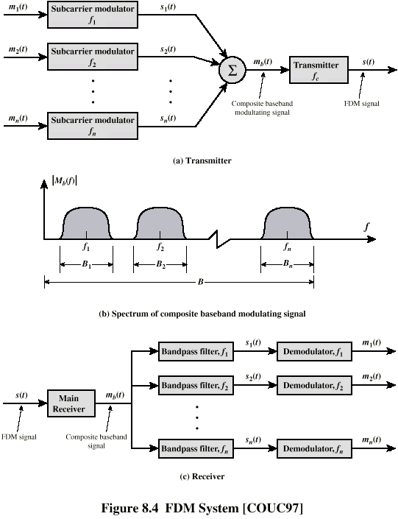
FDM System

Slide 17
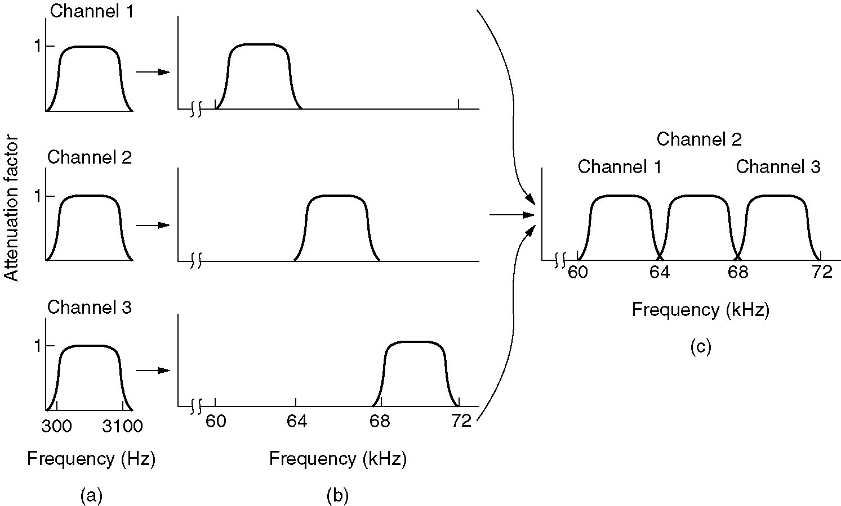
FDM of Three Voiceband Signals

Slide 18
Frequency Division Multiplexing Example
Using cosines and filters…

Slide 19
Asymmetrical Digital Subscriber Line
Link between subscriber and telephone network - local loop – central office
Uses currently installed twisted pair cable
Can carry broader spectrum of 1 MHz or more
Asymmetric
Greater capacity downstream than upstream
Frequency division multiplexing
Lowest 25 kHz for voice – also called Plain Old Telephone Service (POTS)
Two bands for data (smaller for upstream)
Range 5.5km

Slide 20
ADSL Channel Configuration
Oversimplified
Wide gap between POTS and ADSL
Asymmetric

Slide 21
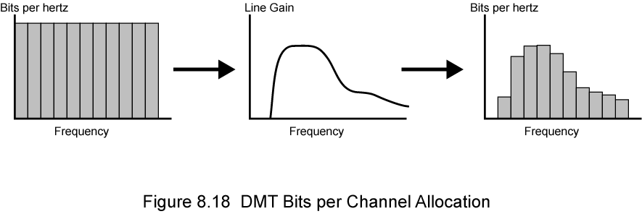
Discrete Multi-Tone (DMT)
Discrete Multi-Tone is ADSL’s modulation technique for data streams
Called OFDM in wireless networks
Uses FDM within upstream and downstream bands
Multiple carrier signals at different frequencies
256 downstream sub-channels at 4 kHz each (60 kbps) for a total of 15.36Mbps
Impairments bring this down to 1.5 Mbps to 9 Mbps
Some bits on each channel (using PSK)
Send test signal and use sub-channels with better signal to noise ratio
Source: Stallings?

Slide 22
Wavelength Division Multiplexing
Optical fiber has huge bandwidth of ~ 30 THz
Several transmissions can proceed on the fiber simultaneously using different optical frequencies (wavelengths) – termed Wavelength Division Multiplexing (WDM)
Each color (wavelength) carries separate data channel
Widely used in core backbone wired networks
Commercial systems of 160 channels of 10 Gbps
Fiber nonlinearities → cross channel interference→ short lengths
Lab systems (Alcatel) 256 channels at 39.8 Gbps each
10 x 1 Tbps
Over 100 km (special fiber)

Slide 23
Types of WDM
Basically differ in terms of channel spacing and quality of equipment
Coarse - wider channel spacing ITU-T G.671 (cheaper)
Most popular 4-10 channels with 20 nm spacing (10 Gbps Ethernet)
Dense WDM > 18 wavelengths per fiber
Abbreviated as DWDM
Specific channels sizes standardized in an ITU Grid G.694.1
For example, 100 GHz → 0.8 nm spacing – 40 channels

Slide 24
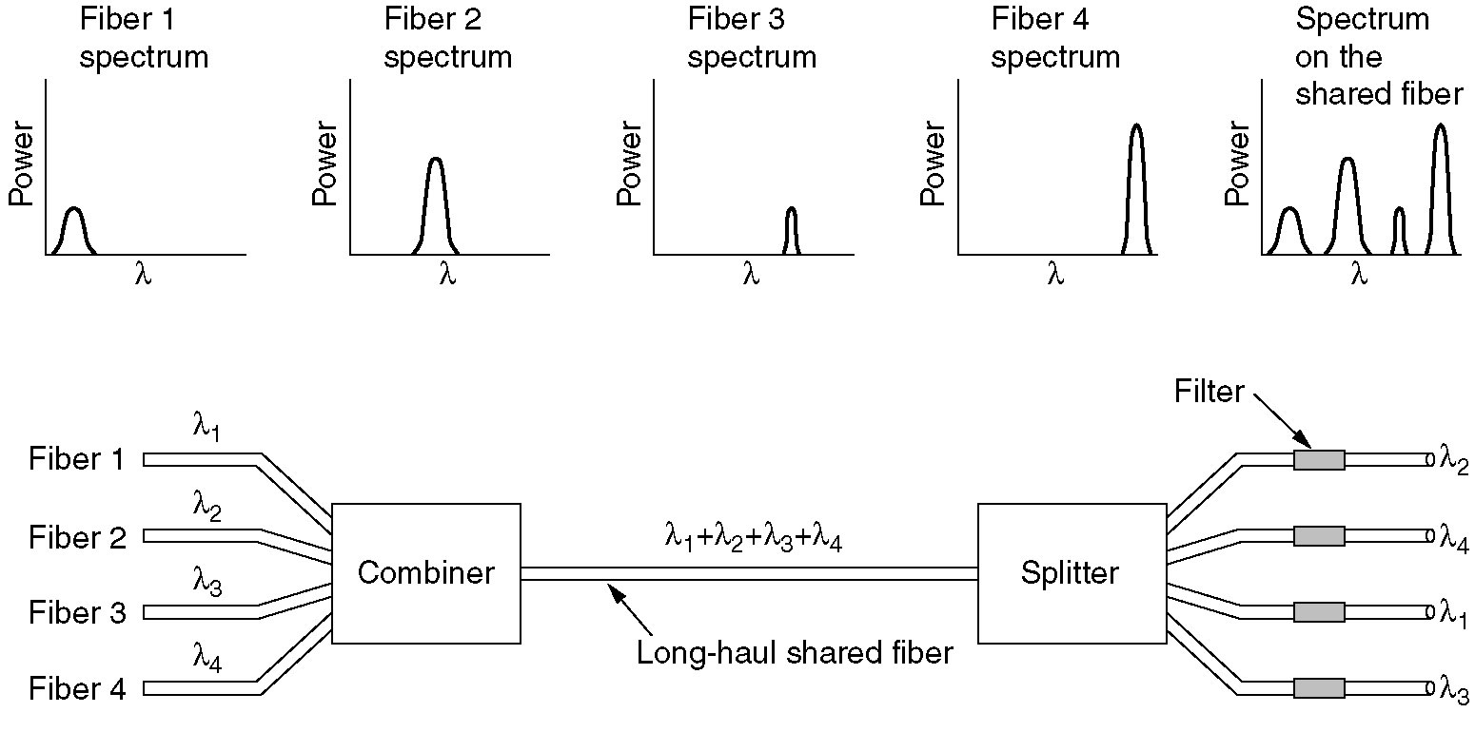
WDM is like FDM!

Slide 25
WDM Operation
Same general architecture as (other) FDM
Number of sources generating laser beams at different frequencies - $$
Multiplexer consolidates sources for transmission over single fiber
Could be a “prism” or a simple combiner
Optical amplifiers amplify all wavelengths
Typically tens of km apart
Mostly 1550 nm wavelength range
Demux (prism) separates channels at destination
Eventually,
Need a WDM repeater

Slide 26
Time Division Multiplexing
Assign a fixed time period to a transmission channel between a sender and a receiver for use of medium– termed a slot
Different users share physical medium on slot by slot basis – take turns!
Requires a level of synchronization among the channels and users
Organize channel sequences into frames – a number of slots
Note a channel is a slot in a frame – allocated even if no data is transmitted

Slide 27






Time Division Multiplexing
Not link layerframe, but PHY layer construct
frame
slot
frequency
time

Slide 28
TDM in Telephone Networks
TDM is basis of digital telephone system and core network lower layer operations
Show DS-0 to DS-1

Slide 29
DS-1 Transmission Format
1
2
3
4
5
6
7
8
Not a packet or Ethernet frame!
Notes:
The basis of the TDM hierarchy (in North America and Japan) is the DS-1 transmission
format (Figure 6.10), which multiplexes 24 channels. Each frame contains
8 bits per channel, 24 channels, plus a framing bit. Hence, each frame is 193 bits
(24 channels * 8 bits per channel + 1 framing bit = 193 bits). For voice transmission,
the following rules apply. Each channel of each frame contains one byte (8 bits) of
digitized voice data. The original analog voice signal is digitized using pulse code modulation
(PCM) at a rate of 8000 samples per second. Therefore, each channel slot and
hence each frame must repeat 8000 times per second. With a frame length of 193 bits,
we have a data rate of 8000 frames per second * 193 bits per frame = 1.544 Mbps.
For five of every six frames, 8-bit PCM samples are used. For every sixth frame,
each channel contains a 7-bit PCM byte plus a signaling bit. The signaling bits form a
stream for each voice channel that contains network control and routing information.
For example, control signals are used to establish a connection or terminate a call.
The same DS-1 format is used to provide digital data service. For compatibility
with voice, the same 1.544-Mbps data rate is used. In this case, 23 channels of
data are provided. The twenty-fourth channel position is reserved for a special sync
byte, which allows faster and more reliable reframing following a framing error.
Within each channel, 7 bits per frame are used for data, with the eighth bit used to
indicate whether the channel, for that frame, contains user data or system control
data. With 7 bits per channel, and because each frame is repeated 8000 times per
second, a data rate of 56 Kbps can be provided per channel. Lower data rates are
provided using a technique known as subrate multiplexing.
Finally, the DS-1 format can be used to carry a mixture of voice and data
channels. In this case, all 24 channels are utilized; no sync byte is provided.

Slide 30
T1/T3 Links
Dedicated channels (private links) – private voice/data/video networks
T1
1.536 Mbps of usable capacity on 1.544 Mbp links
Usually in bulk or as 24 64-kbps sub-channels (DS-0s)
Pricing often makes T1s economical when ≈ 6 DS-0s are used between two locations
Fractional T1 - Purchase/lease ½ or ¼ of a T1
½ T1 = 768 kbps, ¼ T1 = 384 kbps
T3 focused on higher bandwidth users
High capacity service (45 Mbps)
Equivalent to 28 T1s (672 DS-0s)

Slide 31
SONET/SDH
Synchronous Optical Network (SONET) (ANSI)
Synchronous Digital Hierarchy (SDH) (ITU-T)
TDM system for optical links
Basic unit of capacity for network service providers
Signal Hierarchy
Synchronous Transport Signal level 1 (STS-1) or Optical Carrier level 1 (OC-1)
At 51.84 Mbps
Carry DS-3 or group of lower rate signals
(DS1, DS1C, DS2) plus ITU-T rates (e.g. 2.048 Mbps)
Multiple STS-1 combined into STS-N signal
ITU-T rates termed Synchronous Transfer Mode (STM–X)

Slide 32
Sonet/SDH Signal Hierarchy
Notes:
The SONET (Synchronous Optical Network) specification
defines a hierarchy of standardized digital data rates (Table 6.3). The lowest level,
referred to as STS-1 (Synchronous Transport Signal level 1) or OC-1 (Optical Carrier
level 1),4 is 51.84 Mbps. This rate can be used to carry a single DS-3 signal or a group
of lower-rate signals, such as DS1, DS1C, DS2, plus ITU-T rates (e.g., 2.048 Mbps).
Multiple STS-1 signals can be combined to form an STS-N signal. The signal is
created by interleaving bytes from N STS-1 signals that are mutually synchronized.
For the ITU-T Synchronous Digital Hierarchy, the lowest rate is 155.52 Mbps,
which is designated STM-1. This corresponds to SONET STS-3.
The most common data transmission speeds over SONET ranges between
155 Mbps and 2.5 Gbps. To build these data streams, SONET multiplexes lower speed
channels (with bandwidths as low as 64 Kbps) into STS frames.

Slide 33
Mode and Multiplexing
Mode how two parties share a channel during conversation
Simplex – one way communication (e.g., broadcast AM)
Duplex – two way communication
TDD: time division duplex users take turns on the channel
FDD: Frequency division duplex – users get two channels – one for each direction of communication
Rates need not be symmetric (ADSL)
Systems use a combination of mode and multiplexing
Cordless phone CT2 standard: TDD/TDMA
GSM: FDD/FDM/TDMA
Spectrum broken up into 125 channels
User one channel for uplink (mobile to base station) another channel for downlink (base station to mobile)
8 users share one channel in TDM fashion

Slide 34
GSM - TDMA/FDM/FDD
935-960 MHz
124 channels (200 kHz)
downlink
frequency
890-915 MHz
124 channels (200 kHz)
uplink
higher GSM frame structures
time
GSM TDMA frame
1
2
3
4
5
6
7
8
4.615 ms
GSM time-slot (normal burst)
guard
space
guard
space
tail
user data
S
Training
S
user data
tail
3 bits
57 bits
1
26 bits
1
57 bits
3
546.5 µs
577 µs

